Slide 1

Artificial language learning workshop: Lecture 3
James Brand
j.brand@lancaster.ac.uk

Slide 2
Overview
Artificial Language Learning
PsychoPy
http://psychopy.org/installation.html

Slide 3
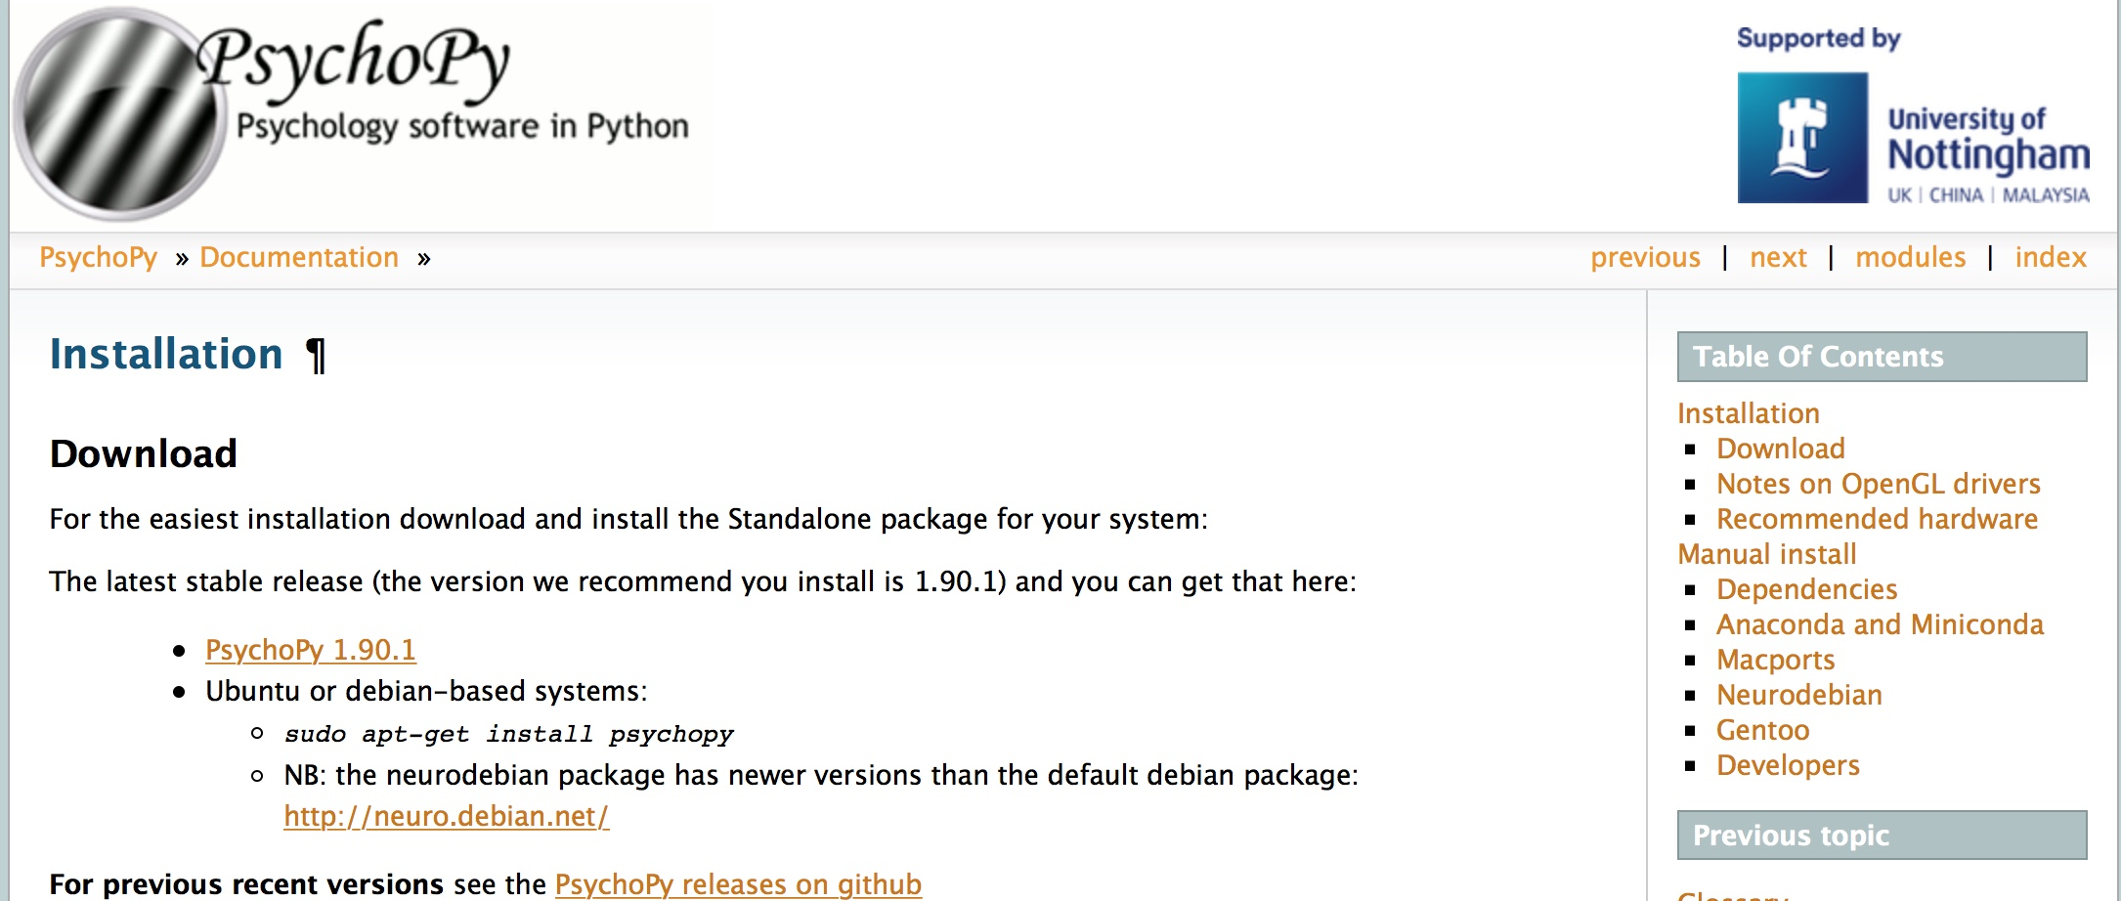
Overview
Artificial Language Learning

Slide 4
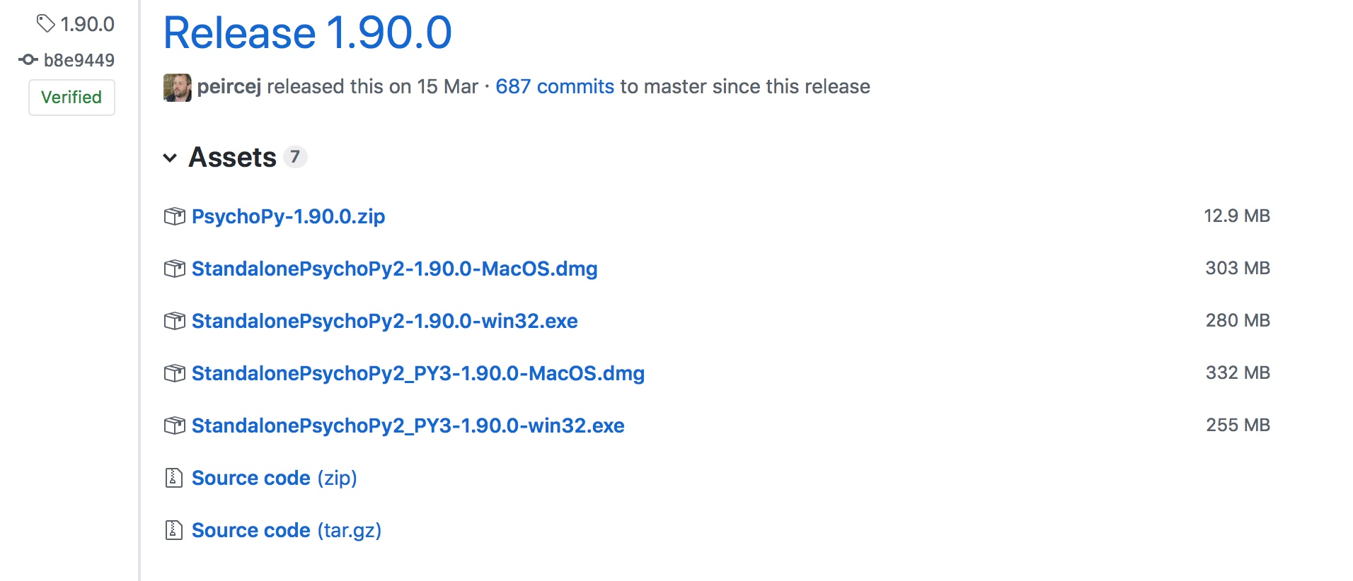
Overview
Artificial Language Learning

Slide 5
Overview
Artificial Language Learning
Materials
https://github.com/jamesbrandscience/SSoL_2018

Slide 6

Overview
Artificial Language Learning

Slide 7
Overview
Artificial Language Learning
Recap
What ALL is and why it is useful
Validity of ALL paradigm
Different types of ALL experiments

Slide 8
Overview
Artificial Language Learning
Still to do
A few more examples of ALL
Taking part in an ALL experiment (PsychoPy)
Understanding the design and architecture
Interpreting the output and looking at results

Slide 9
Overview
Artificial Language Learning
ALL and communication
Part V:
ALL and communication

Slide 10
Overview
Artificial Language Learning
ALL and communication
A question…
How does communication affect the evolution of language

Slide 11
Overview
Artificial Language Learning
ALL and communication
A prediction…
We start off with icons that evolve to become symbolic
Garrod et al. (2007)

Slide 12
Overview
Artificial Language Learning
ALL and communication
An example…
Garrod et al. (2007)

Slide 13


Overview
Artificial Language Learning
ALL and communication
An example…
Garrod et al. (2007)

Slide 14
Overview
Artificial Language Learning
ALL and communication
A theory…
Pressures for efficient communication result in the evolution of more symbolic graphical forms
Garrod et al. (2007)

Slide 15
Overview
Artificial Language Learning
ALL and communication
A problem…
Using pre-existing character systems may not provide a clear understanding of what is actually going on
Garrod et al. (2007)

Slide 16
Overview
Artificial Language Learning
ALL and communication
A solution…
Get participants into a laboratory and see how communication influences the evolution of graphical systems
Garrod et al. (2007)

Slide 17
Overview
Artificial Language Learning
ALL and communication
An experiment…
Garrod et al. (2007)

Slide 18
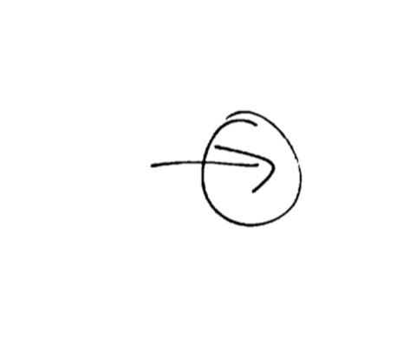
Overview
Artificial Language Learning
ALL and communication
An experiment…
Garrod et al. (2007)

Slide 19
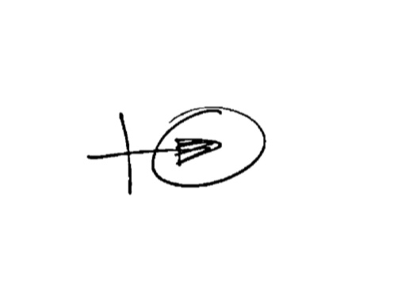
Overview
Artificial Language Learning
ALL and communication
An experiment…
Garrod et al. (2007)

Slide 20
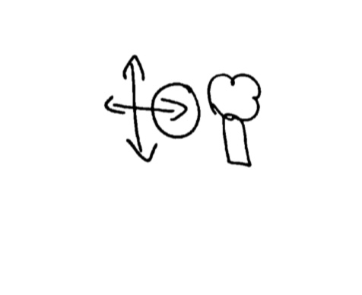
Overview
Artificial Language Learning
ALL and communication
An experiment…
Garrod et al. (2007)

Slide 21
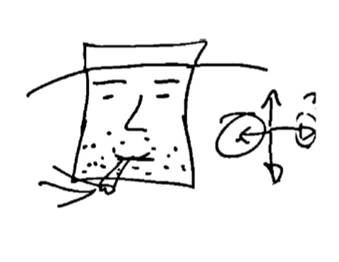
Overview
Artificial Language Learning
ALL and communication
An experiment…
Garrod et al. (2007)

Slide 22
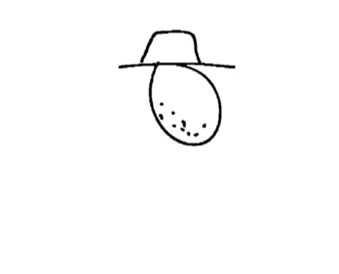
Overview
Artificial Language Learning
ALL and communication
An experiment…
Garrod et al. (2007)

Slide 23
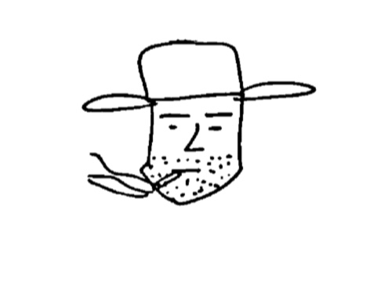
Overview
Artificial Language Learning
ALL and communication
An experiment…
Garrod et al. (2007)

Slide 24
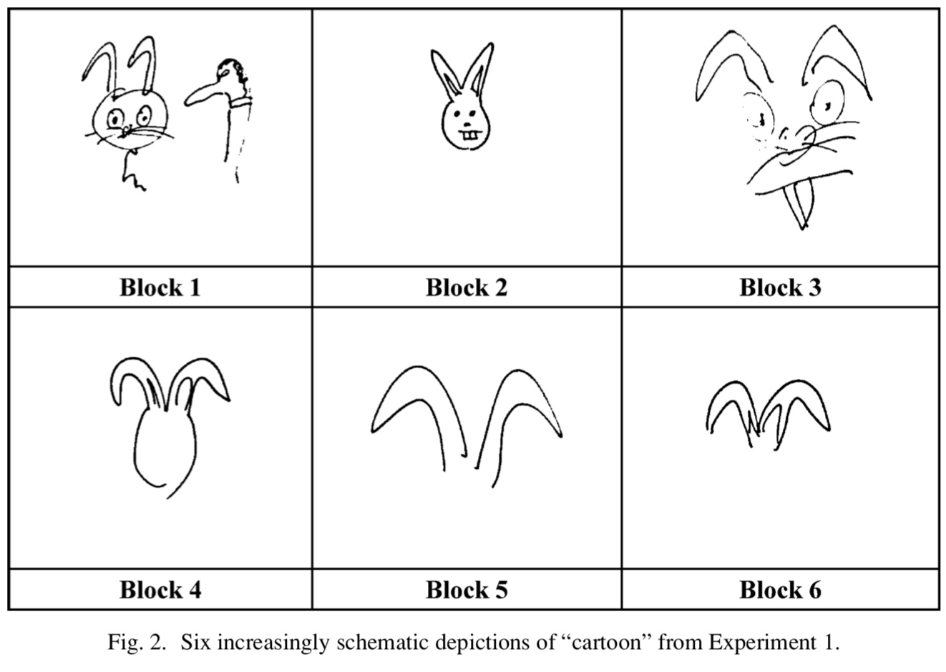
Overview
Artificial Language Learning
ALL and communication
Garrod et al. (2007)

Slide 25
Overview
Artificial Language Learning
ALL and communication
A design…
Make participants generate their own graphical representations of concepts
Impose a pressure to communicate efficiently and accurately
Observe how repeated communication influences graphical representations
Garrod et al. (2007)

Slide 26
Overview
Artificial Language Learning
ALL and communication
A result…
Representations start off being iconic and complex
But with repeated communication trials, they become less complex but more symbolic
Graphical systems evolve from icons to symbols as a result of communicative pressures
Garrod et al. (2007)

Slide 27
Overview
Artificial Language Learning
ALL and communication
A prediction…
Language has evolved to become learnable and communicatively efficient
Kirby et al. (2015)

Slide 28
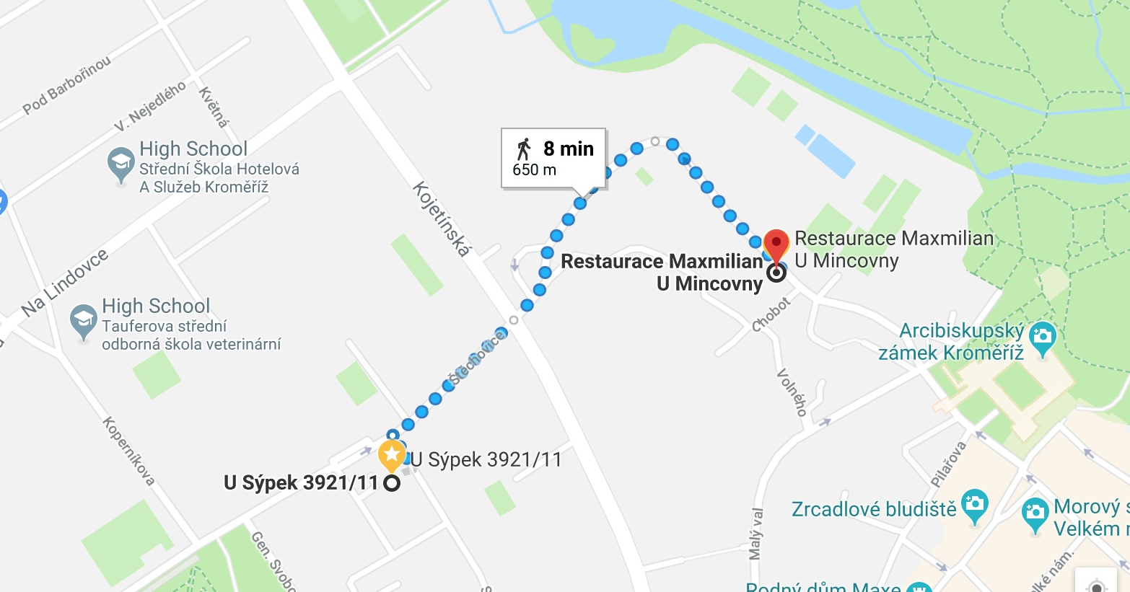
Overview
Artificial Language Learning
ALL and communication
An example…

Slide 29

Overview
Artificial Language Learning
ALL and communication
An example…

Slide 30
Overview
Artificial Language Learning
ALL and communication
A theory…
We need to use language that is efficient to understand but also easy to acquire
Kirby et al. (2015)

Slide 31
Overview
Artificial Language Learning
ALL and communication
A problem…
We do not know how this trade-off between language learning and language use comes from

Slide 32
Overview
Artificial Language Learning
ALL and communication
A solution…
Test how languages evolve by placing communicative and learning pressures on the participants
Kirby et al. (2015)

Slide 33
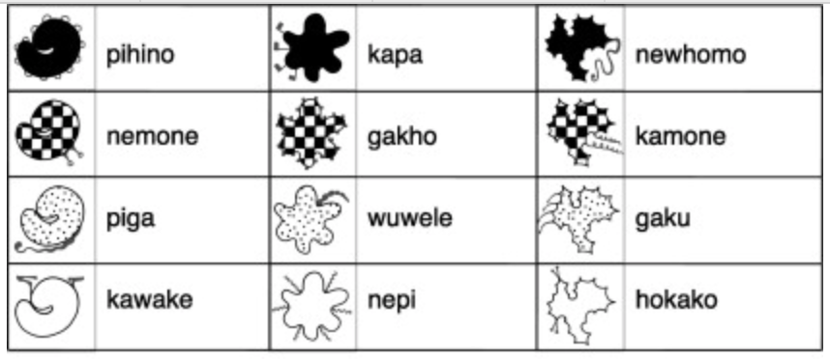
Overview
Artificial Language Learning
ALL and communication
An experiment…
Kirby et al. (2015)

Slide 34
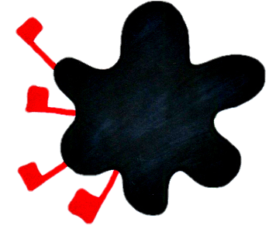
Overview
Artificial Language Learning
ALL and communication
An experiment…
kapa
Kirby et al. (2015)

Slide 35
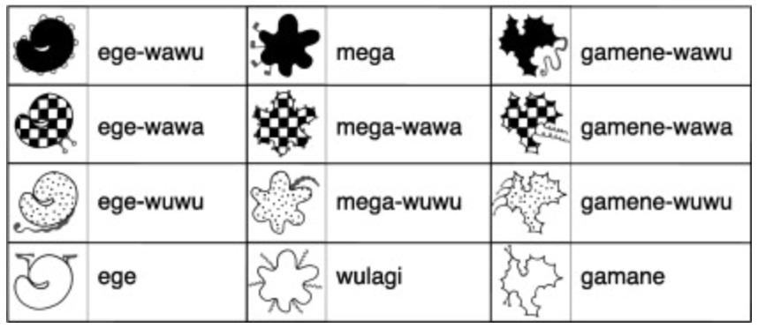
Overview
Artificial Language Learning
ALL and communication
An experiment…
Kirby et al. (2015)

Slide 36
Overview
Artificial Language Learning
ALL and communication
A design…
Pairs of participants learn the same language
They then have to communicate that language with a partner
Pass on the newly communicated language to the next pair of participants
Kirby et al. (2015)

Slide 37
Overview
Artificial Language Learning
ALL and communication
A result…
Systems emerge that can be learnt more easily
Systems emerge that can be communicatively effective i.e. expressivity
Kirby et al. (2015)

Slide 38
Overview
Artificial Language Learning
ALL without the language
Part VI:
ALL without the language

Slide 39
Overview
Artificial Language Learning
ALL without the language
A question…
How can we test predictions about language without using language

Slide 40
Overview
Artificial Language Learning
ALL without the language
A prediction…
There are ways to communicate non-linguistically but still incorporate linguistic properties

Slide 41
Overview
Artificial Language Learning
ALL without the language
An example…
https://www.youtube.com/watch?v=-7ijI-g4jHg

Slide 42
Overview
Artificial Language Learning
ALL without the language
A theory…
We can use non-linguistic sounds to communicate meanings to each other

Slide 43
Overview
Artificial Language Learning
ALL without the language
A problem…
We tend to use non-linguistic communication in everyday speech

Slide 44
Overview
Artificial Language Learning
ALL without the language
A solution…
Give participants a slide whistle so they have a novel communication modality
Verhoef et al. (2015)

Slide 45



Overview
Artificial Language Learning
ALL without the language
An experiment…
Verhoef et al. (2015)

Slide 46
Overview
Artificial Language Learning
ALL without the language
An experiment…
Verhoef et al. (2015)

Slide 47

Overview
Artificial Language Learning
ALL without the language
An experiment…
Verhoef et al. (2015)

Slide 48
Overview
Artificial Language Learning
ALL without the language
A design…
Participants create their own non-linguistic signals to communicate meanings
These signals are recorded and passed onto the next generation of learners
Meaning stimuli are either easy or difficult to communicate with iconic whistles
Verhoef et al. (2015)

Slide 49
Overview
Artificial Language Learning
ALL without the language
A result
Iconic whistles emerge over the course of iterated learning, but only for the easy to represent meanings
Participants can utilise theoretically motivated communication without linguistic sounds
Verhoef et al. (2015)

